Slide 1
Comprehensive Dental Clinic Management System

Slide 2

Problem Statement
Unexpected cancellations, poor communication, and insufficient medical records are problems that doctors deal with. Additionally, some patients disregard follow-up evaluations, which breaks the continuity of treatment.
Our Meeting

Slide 3
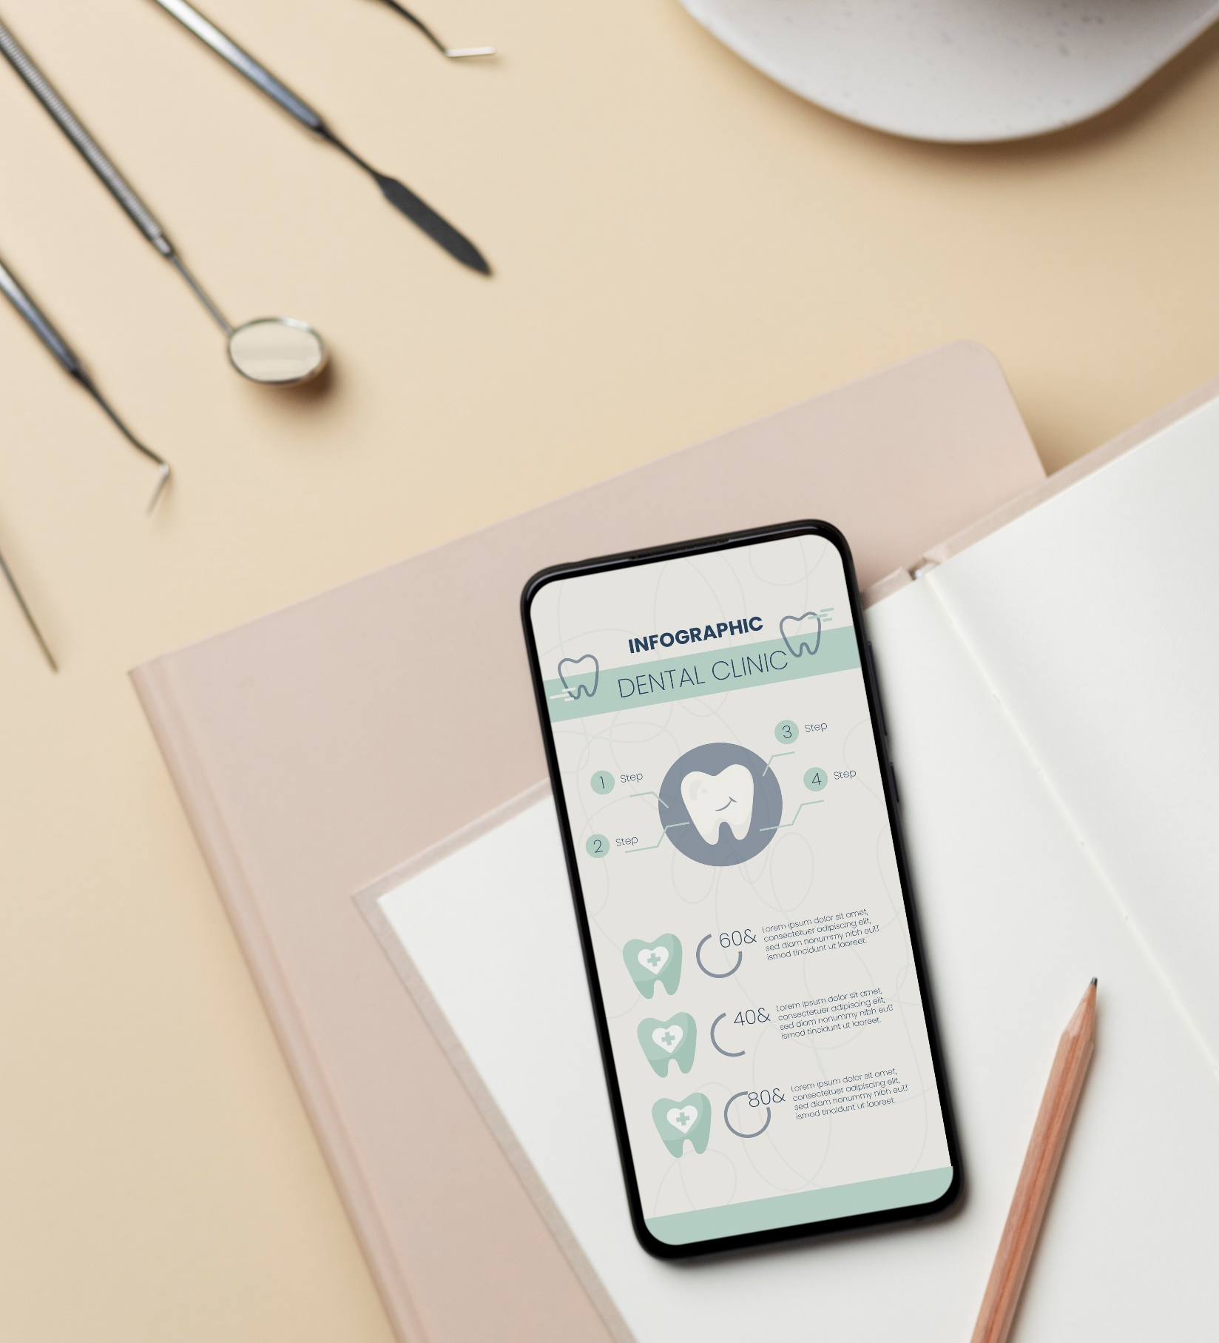
It seeks to solve the waiting problem instead of going directly to the doctor and to facilitate communication between the patient and the dentist to receive medical advice, which will save time for both doctors and patients.
The Objective

Slide 4
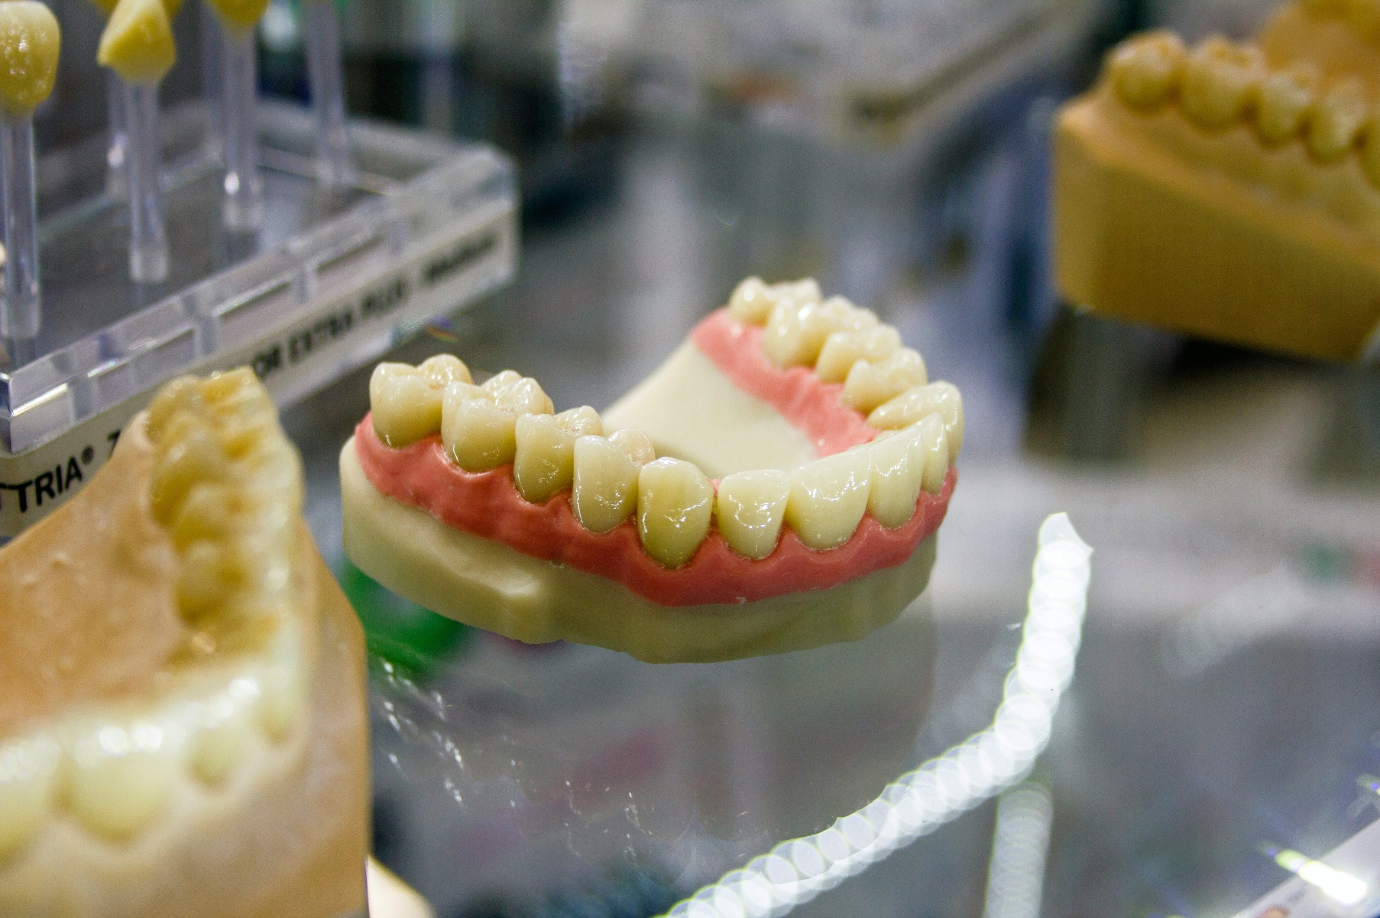
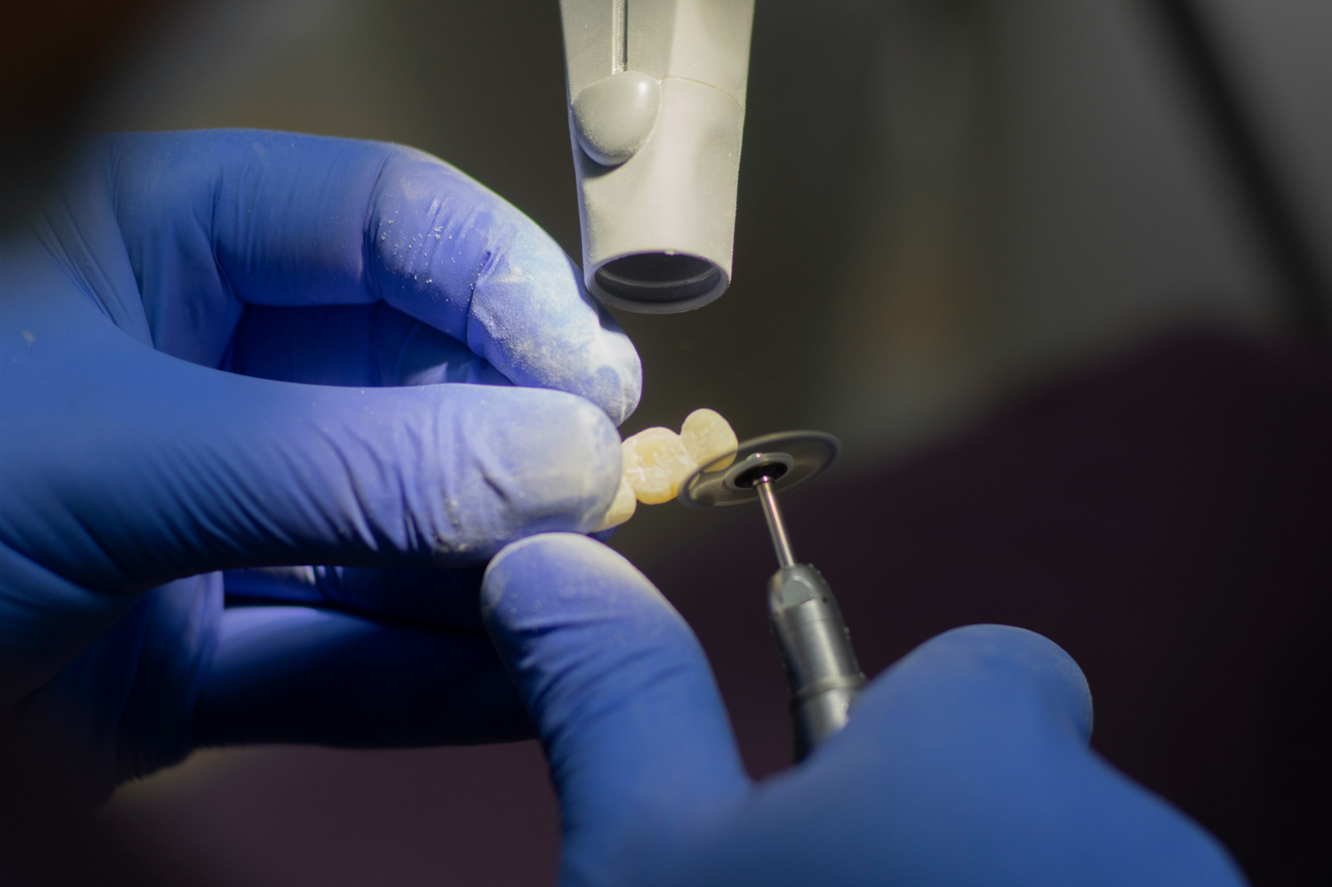
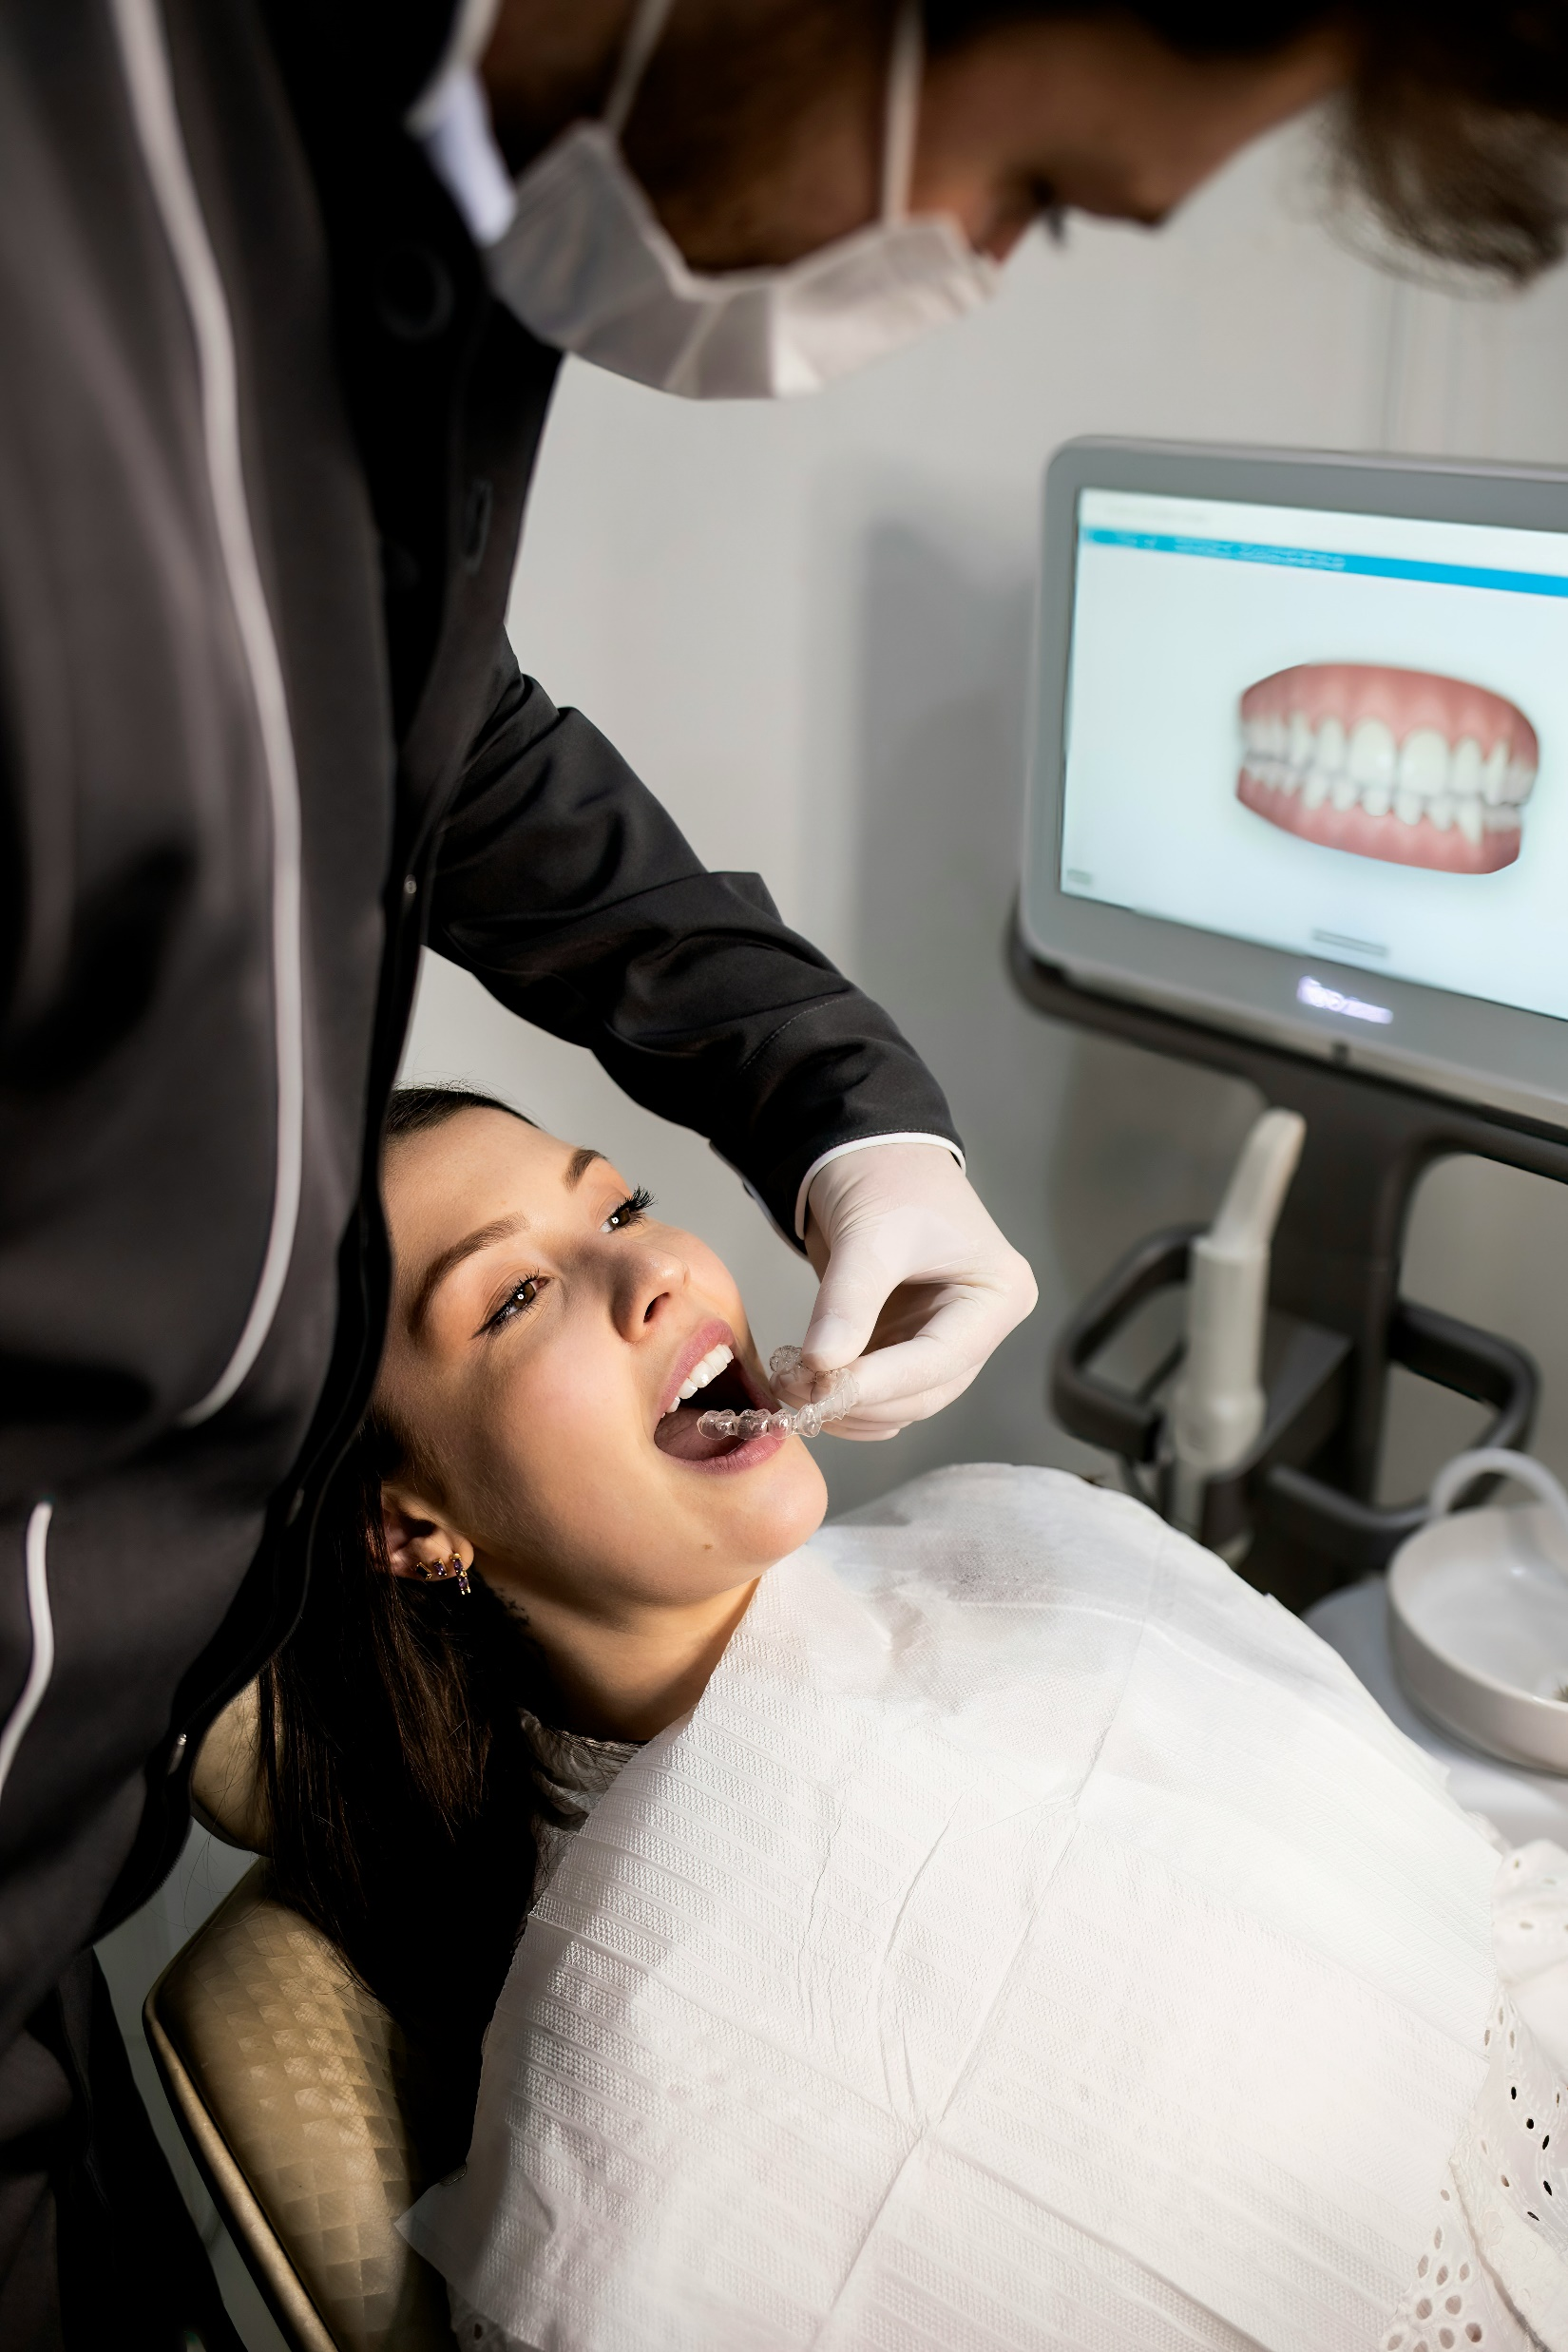
1. It is a tool for dentist and patient to communicate with each other.
Important
1
2. Provide a report about the patient's condition from his dentist.
2
3. Helps save time for both patient and dentist
3
4. Allows patient to book appointments online
4

Slide 5
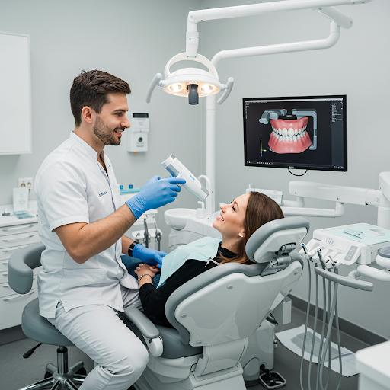
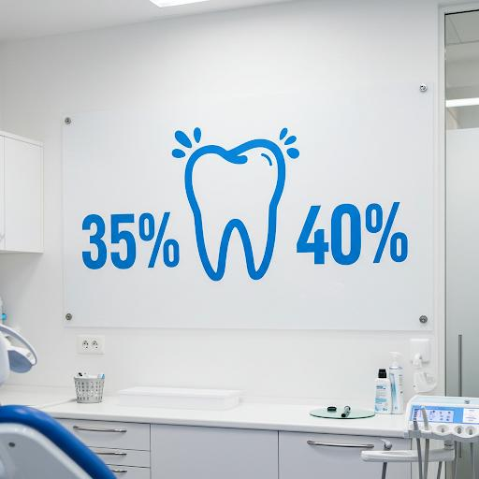
Literature review
Digital Transformation in Clinic Management and Improving Efficiency:
Digital clinic management systems decrease errors and increase efficiency. For example, they cut errors by 40% and enhance appointment scheduling by 35%.

Slide 6

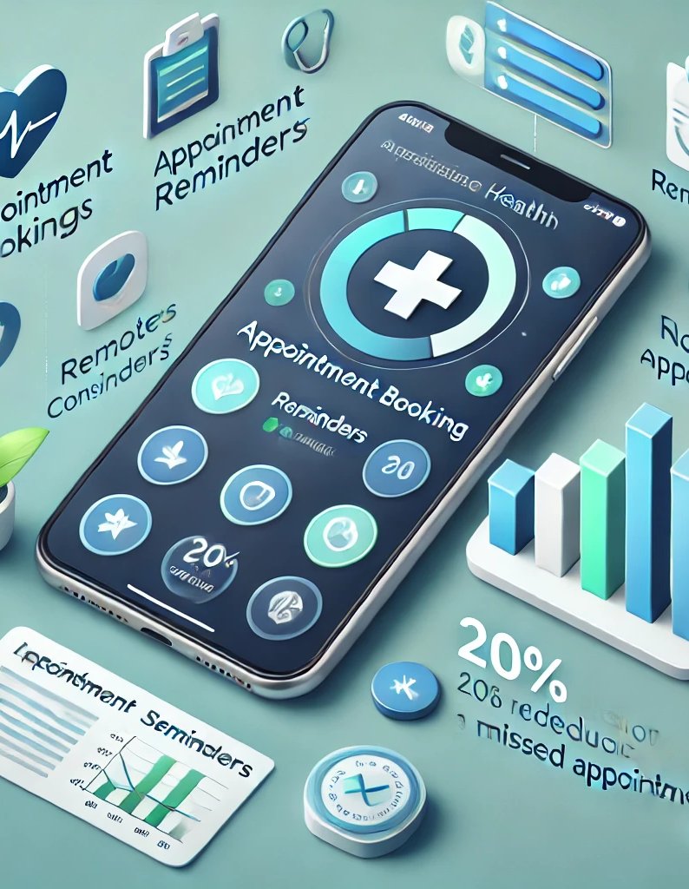
Literature review
The role of mobile applications in improving patient engagement:
By enabling remote scheduling and reminders, health apps help patients be happier and cut down on 20% of missed appointments.

Slide 7
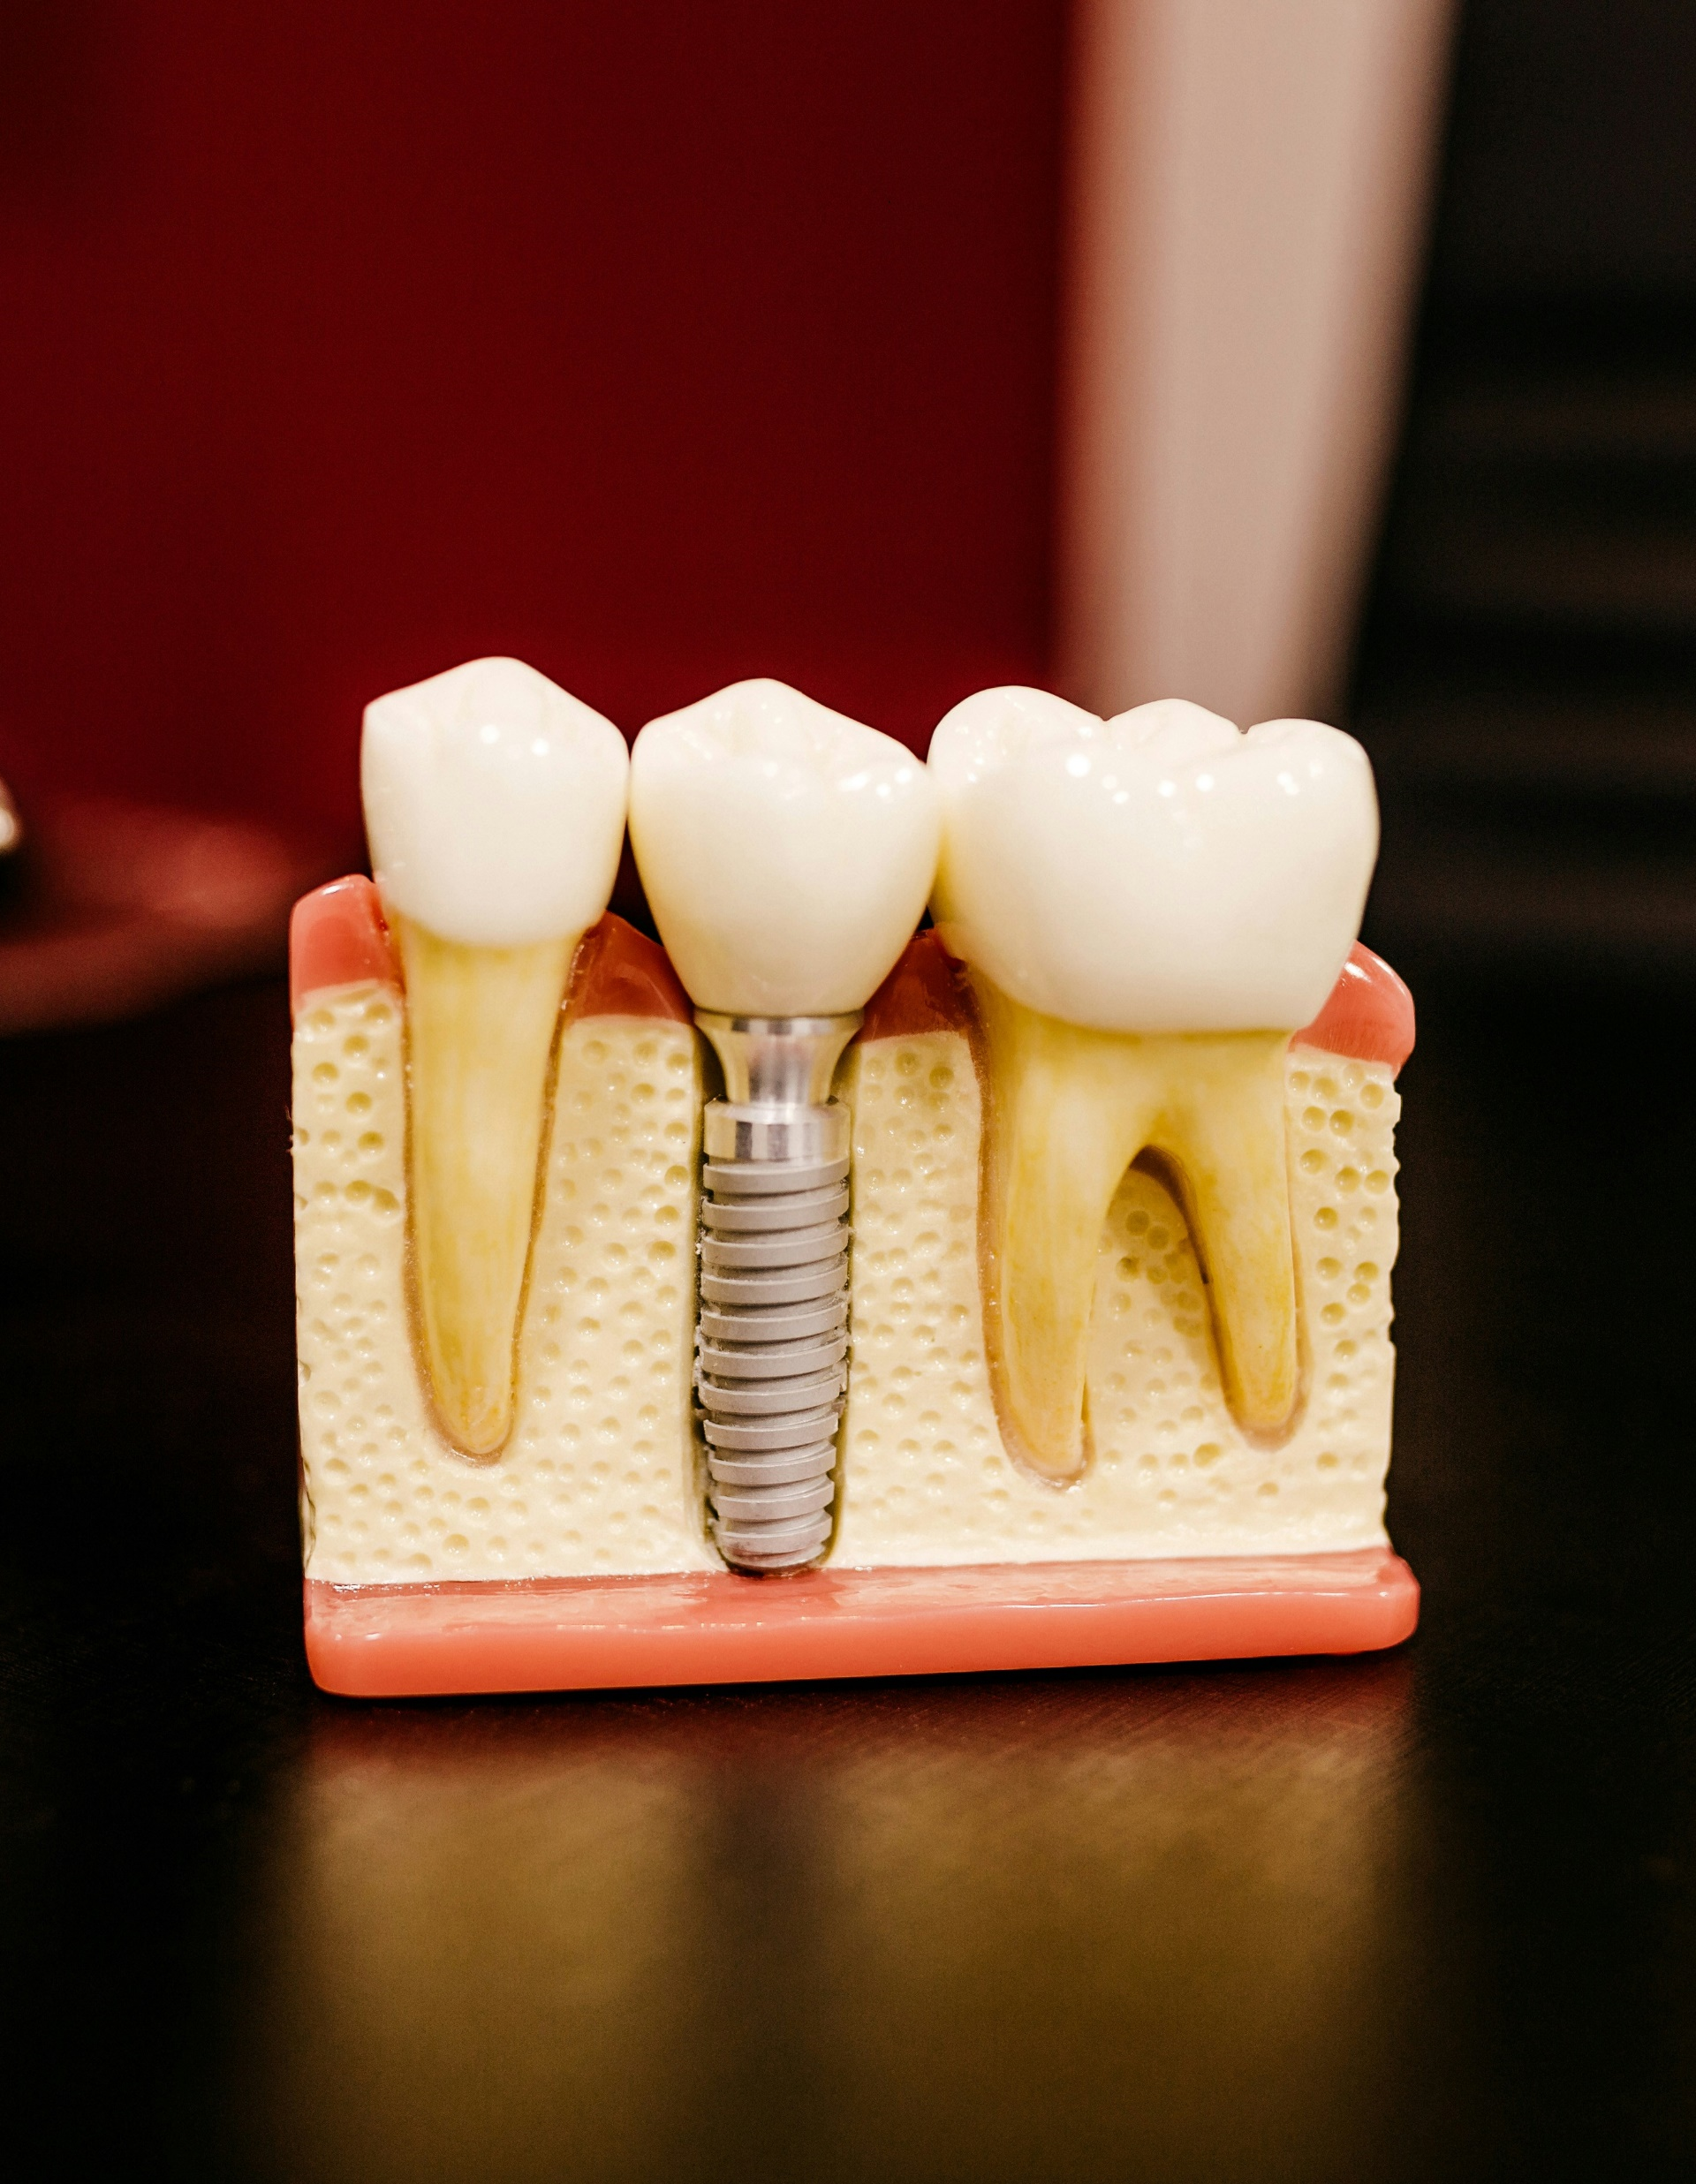
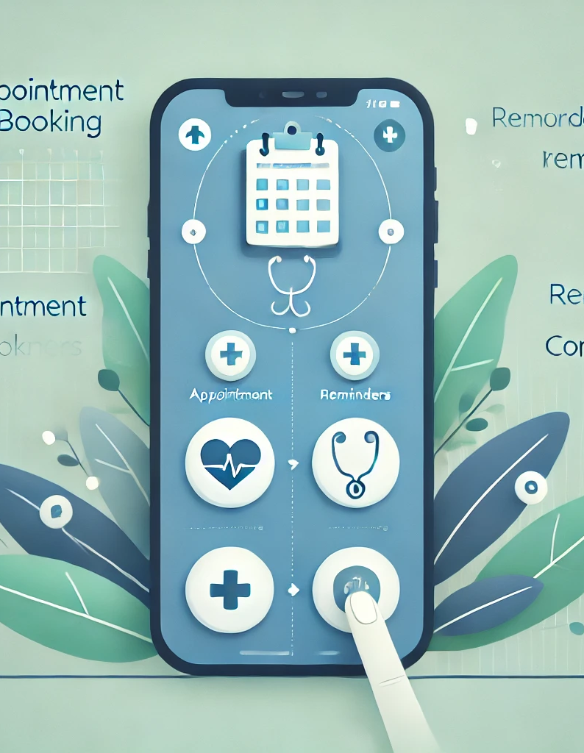
Literature review
User-driven interactive design
Health applications improve patient-clinician engagement by enabling remote appointment scheduling, reminders, and consultations.

Slide 8
01
Methodology
Requirement Analysis
02
The waterfall model of the Software Development Life Cycle (SDLC) has been used for this project . The five phases of the project are:
Design
03
Implementation
04
Testing
05
Deployment

Slide 9

Requirement Analysis
Through the use of contemporary technology, the system seeks to streamline dentist-to-dental list contact and patient information access. The fundamental procedures for requirements analysis are:
2
Patient Management ,
Appointment Booking ,
Reminders.
Functional
Requirements
Identifying
stakeholders
Non-Functional
Requirements
1
3
Clinic Owners,
Dentists ,
Patients ,
Technical Team .
Performance ,
Security ,
Usability ,
Compatibility ,
Availability ,
Maintenance .

Slide 10

Design
Concepts are turned into a useful, aesthetically pleasing website with vital functionality and user-friendly interfaces through the design process. It seeks to demonstrate the clinic's dedication to providing high-quality care and communication.
GESTURE

Slide 11

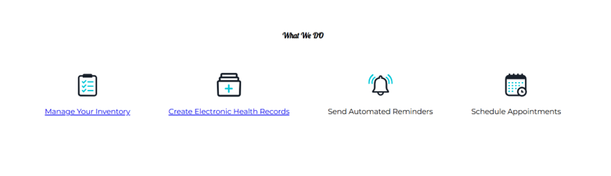
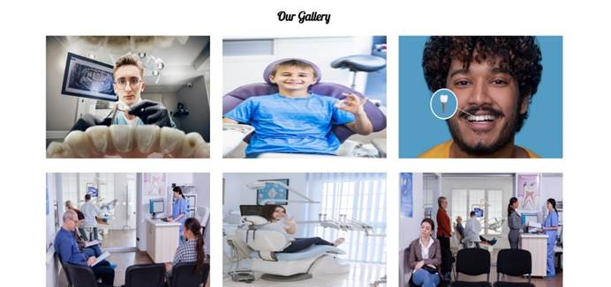
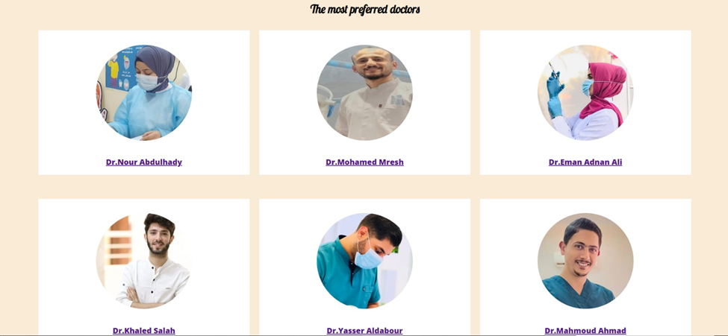

Implementation
Home Page

Slide 12
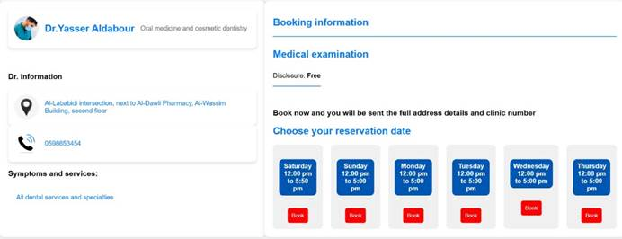
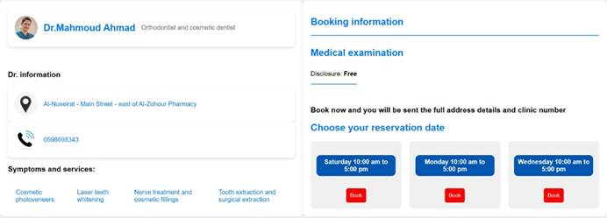
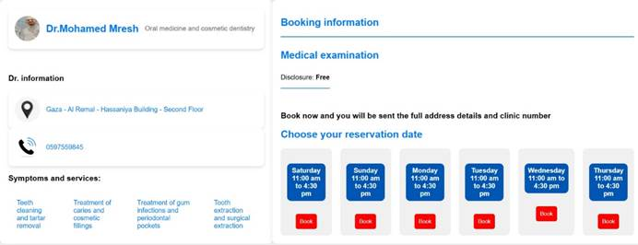
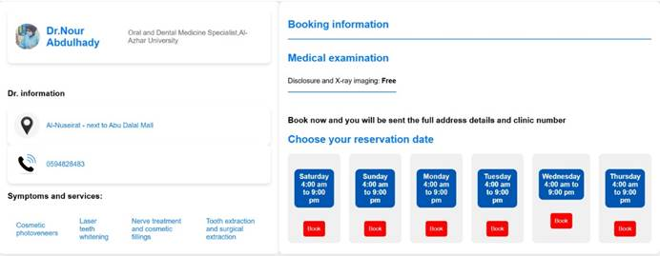
Implementation
Doctor’s Profiles
First Doctor’s Page
Second Doctor’s Page
Fourth Doctor’s Page
Third Doctor’s Page

Slide 13
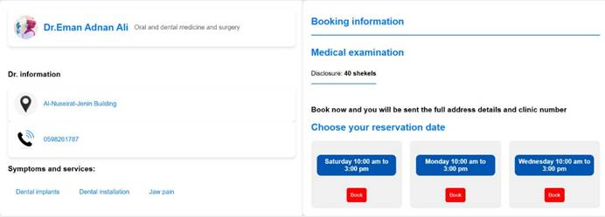
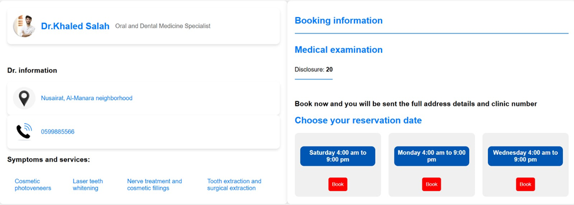
Implementation
Doctor’s Profiles
Fifth Doctor’s Page
Sixth Doctor’s Page

Slide 14
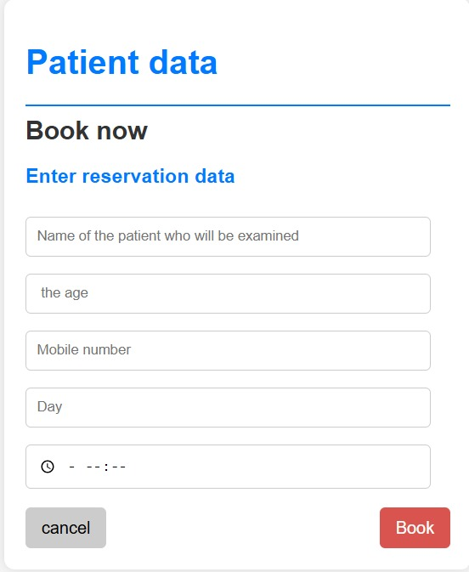
Implementation
Appointment Booking Page

Slide 15
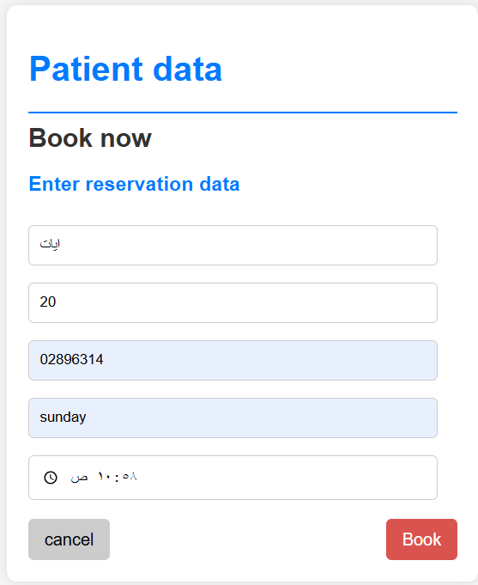
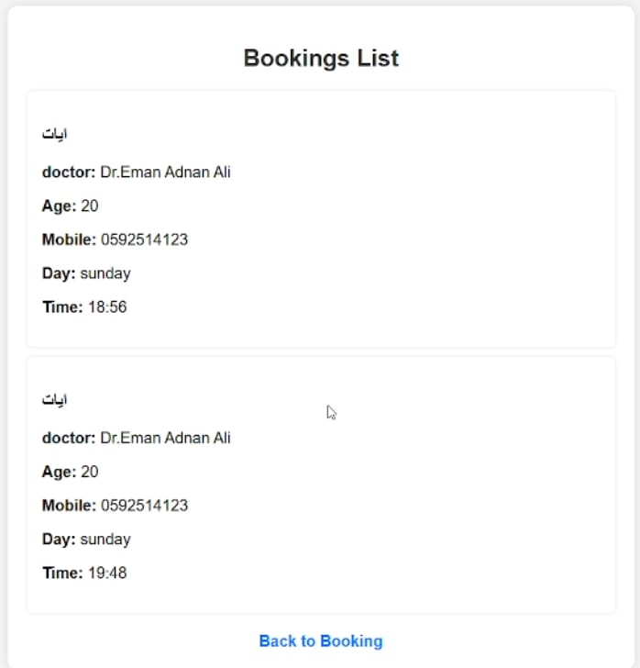

Testing
Pre-registration booking list page
Registration booking list page
Post-registration booking list page

Slide 16
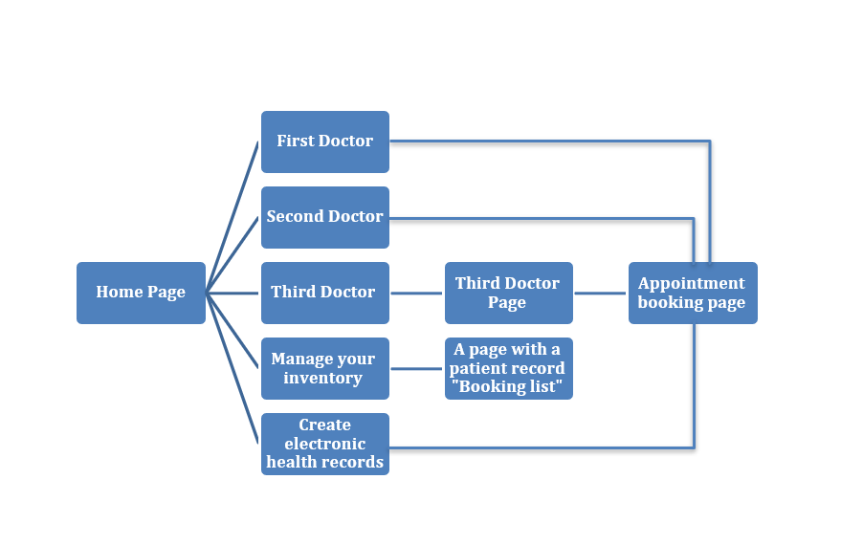
Results
When you click on the first doctor page
When you click on the second doctor page

Slide 17
Discussion
The project provides a practical and efficient solution for updating dental clinic operations, opening the door for more innovations in healthcare management. This work shows how technology can contribute to improving the quality of medical services and patient satisfaction while maintaining high operational efficiency . The modern dental clinic management system project simplifies appointment scheduling, record management, and enhances communication, thereby improving efficiency and ensuring data security. Results have demonstrated reduced wait times, fewer cancellations, and increased patient satisfaction. The project highlights the role of technology in improving healthcare with the potential for future feature development.

Slide 18

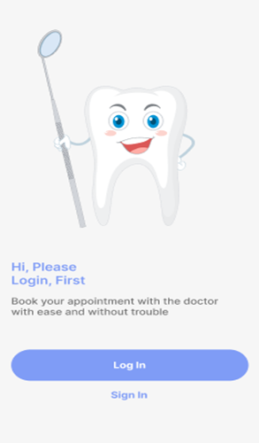
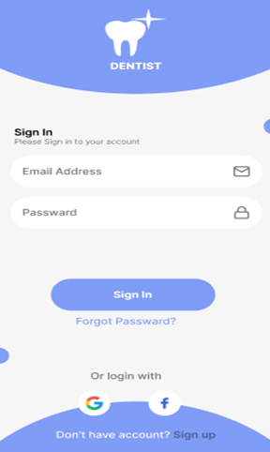
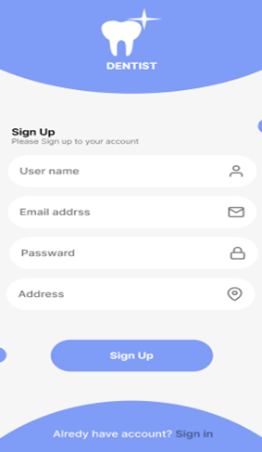
Future Work
Technology enhances dental care and clinic management through a mobile app prototype

Slide 19
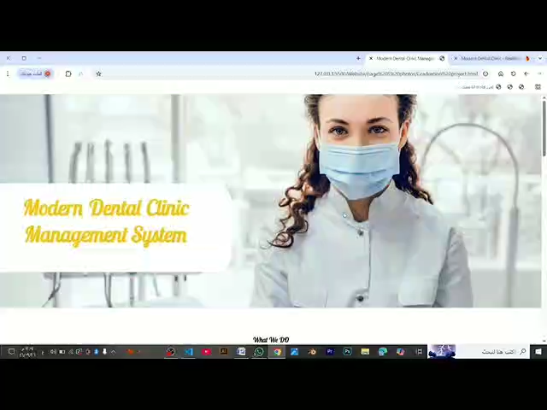
Demo

Slide 20
Q&A

Slide 21
THANKS
By Student Name:
Ayat Salah al-Agha Eman Mushir Al-Bashiti
Ghadeer Rizk al-Bashiti Nour atef al-Masry
Supervised by:
Eng: Nada Usama Fathy Shehata Attia
Eng: Ahmed Nasser

